Slide 1

The Onion Router
How safe do you feel when browsing the internet?
By Robert Gutierrez

Slide 2

Background
Developed mid 1990’s by U.S Naval Research
Creators: Paul Syverson, Michael Reed, David Goldschlag
Further Developed in 1997 by DARPA ( Defense Advance Research Project Agency)

Slide 3
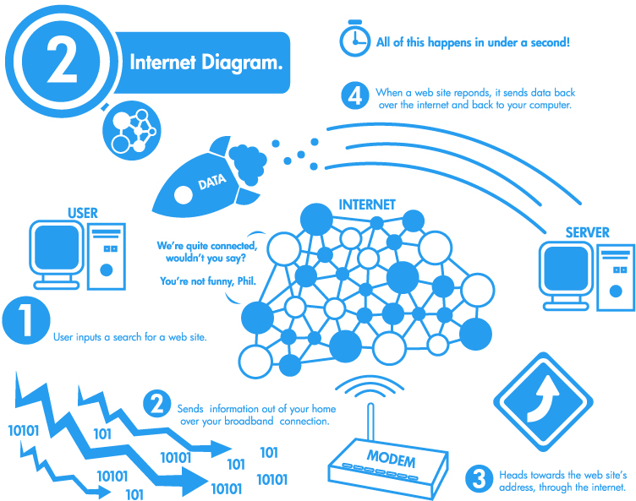
How the internet works

Slide 4
Using Tor
Join the Tor network.
Your desired URL is encrypted
Your information is relayed through various nodes in the network.
Eventually reaches destination and then get sent back.

Slide 5
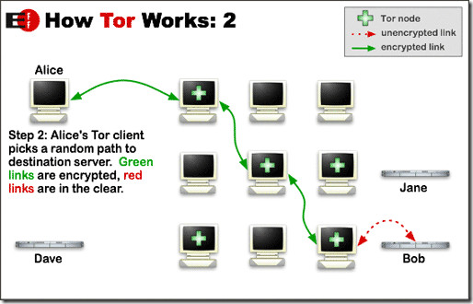
How it works

Slide 6
VPN
Virtual Private Network.
Establishes a virtual point to point connection.
Encrypted data, traveling through a tunnel
Can provide extra security combining it with Tor.

Slide 7
Weaknesses
Even though you can browse anonymously, it is still known that you are using Tor.
Must be carful on how you use Tor. Using 3 party applications can be dangerous.
Tor guarantees anonymity, but not privacy
Speed

Slide 8
Who can Benefit?
Journalist
Law Enforcement
Activist
Businesses & Corporate World
Bloggers
IT Professionals
Normal People

Slide 9
Discussion Questions #1
How do you feel about 3rd party users or government officials viewing your data? Should we be concerned?

Slide 10
Discussion Questions #2
Often media portrays anonymity as a hazard because it allows illicit activity, such as buying drugs, weapons, or hiring hit men. Do you think services like Tor should be shut down for those reason?

Slide 11
Discussion Question #3
Do you see the internet changing in the future?

